Slide 1
补充概念
More Concept about SQL

Slide 2
NULL search condition
The operator NULL means the data value for the column is unknown or not available.
NULL is not synonymous with
zero (numeric or binary value)
a zero-length string,
blank (character value)

Slide 3
CON...
[Example]
If we select only the records with no NULL values in the " GPA " column, we will have to use the IS NOT NULL operator:
    SELECT * FROM students
    WHERE GPA IS NOT NULL

Slide 4
SQL Aggregate Functions
SQL aggregate functions are used to sum, count, get the average, get the minimum and get the maximum values from a column or from a sub-set of column values.
COUNT
AVG
MAX
MIN
SUM

Slide 5
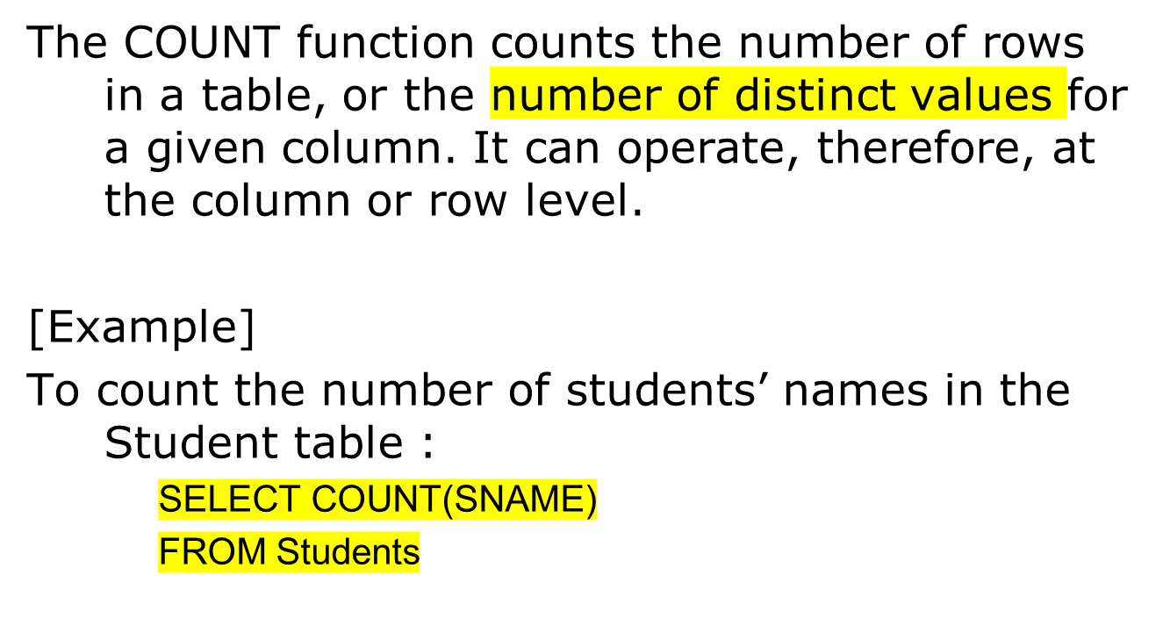
COUNT function
Count计数会去掉重复的记录

Slide 6
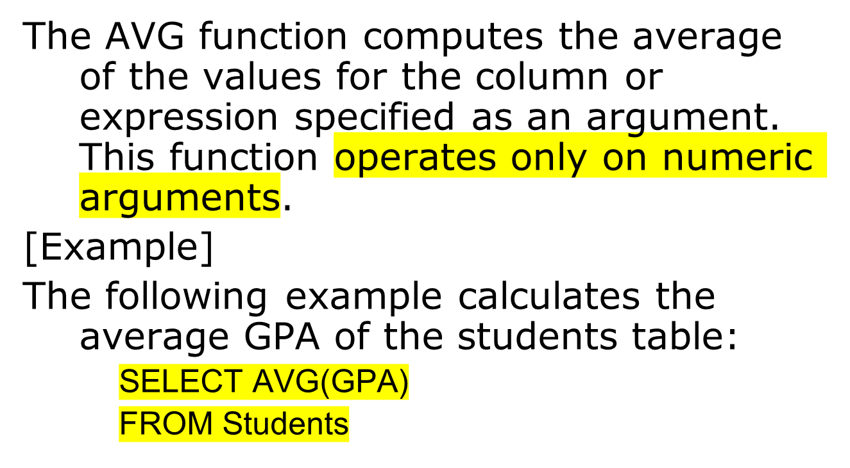
AVG function
求解avg时不包含null值

Slide 7
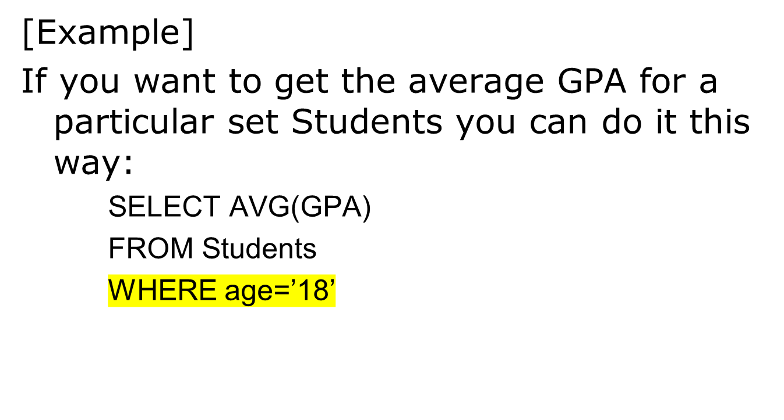
CON...

Slide 8
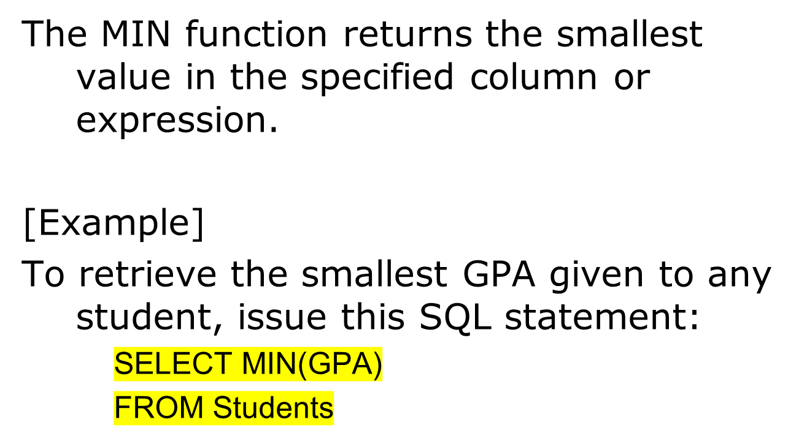
MIN function
不包含null值

Slide 9
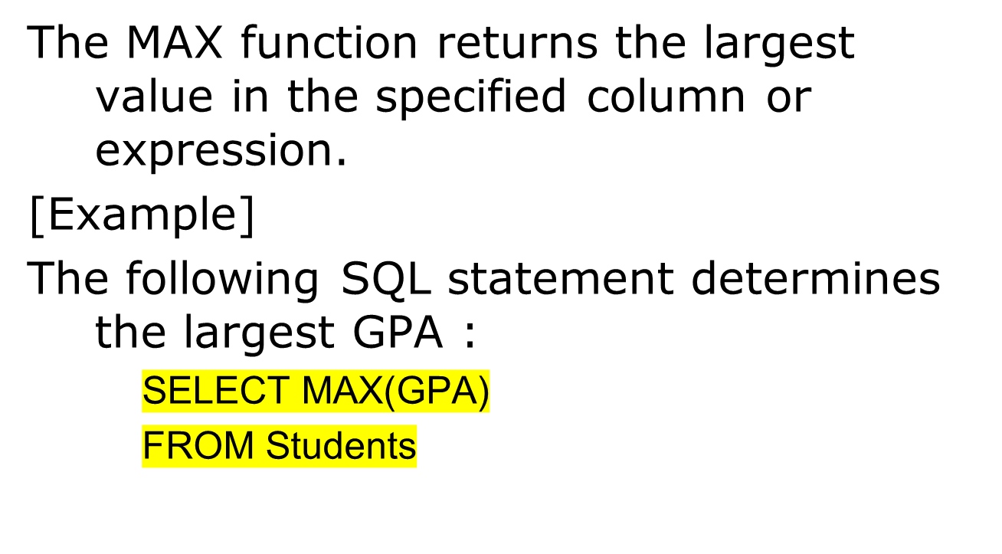
CON...
不包含null值

Slide 10
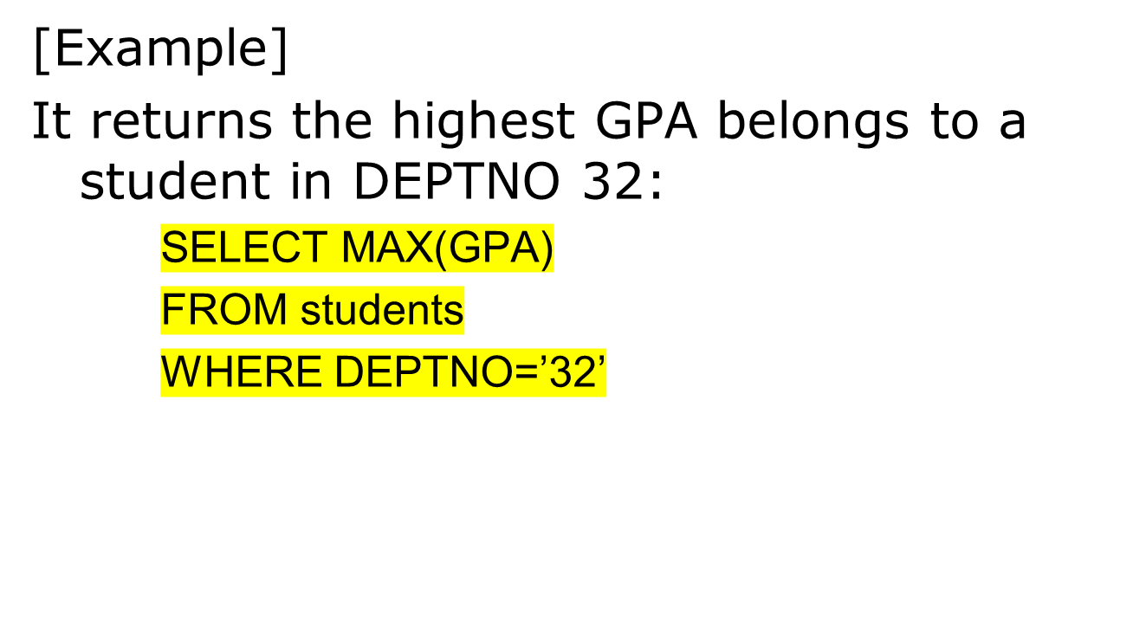
CON...

Slide 11
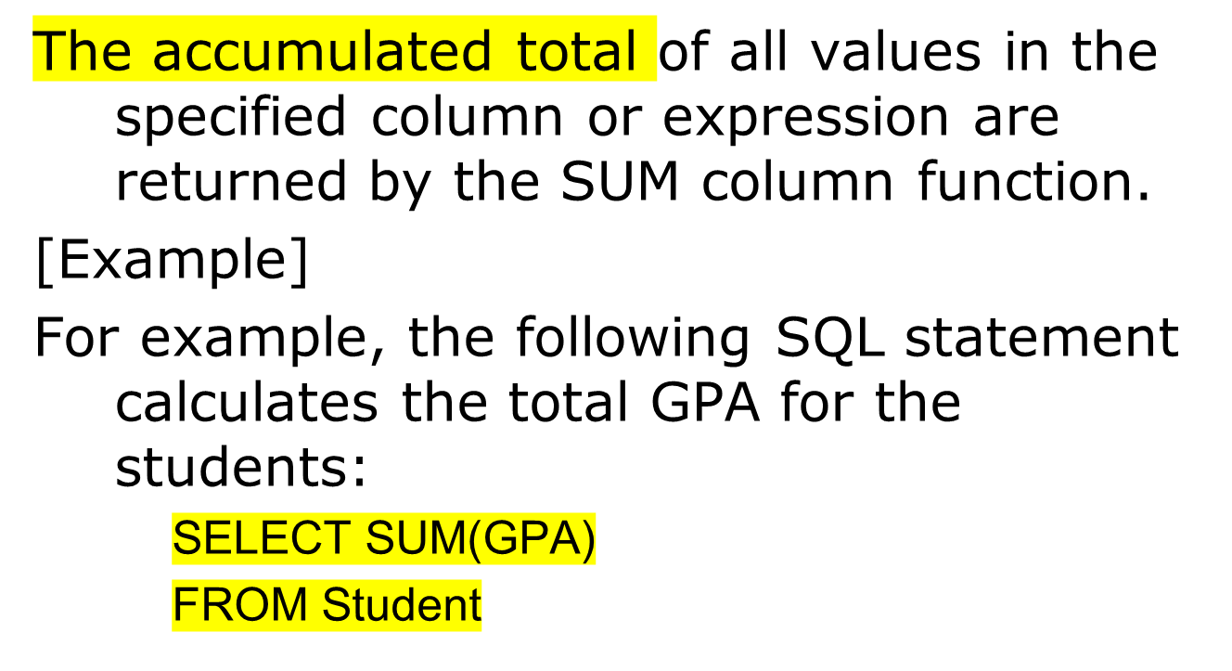
SUM function
不包含null值

Slide 12
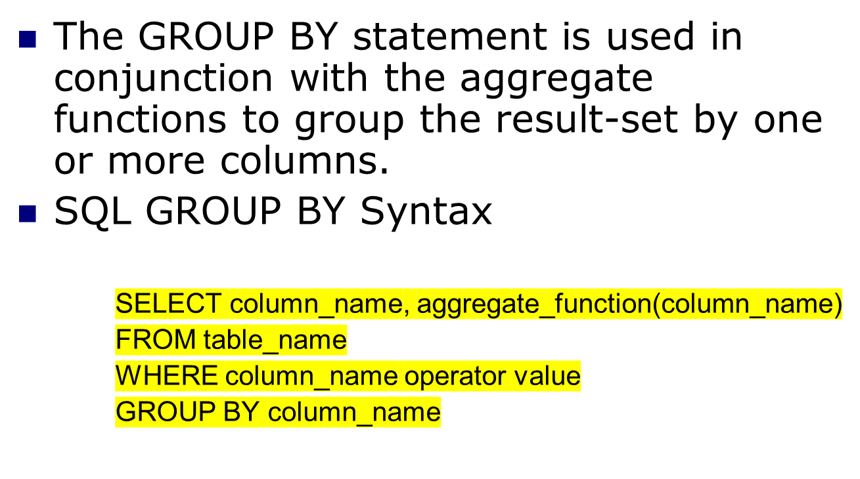
GROUP BY
Group by 进行分组，通过聚合函数计算相关属性

Slide 13
CON...
[Example]
Want to find the average grade of each student.
    SELECT Avg(grade)
    FROM Enrollment
    GROUP BY SID

Slide 14
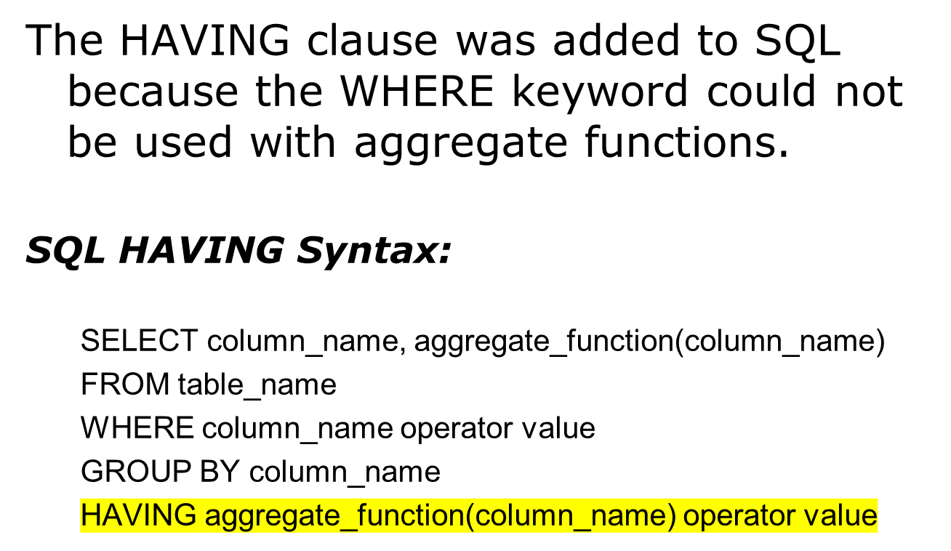
HAVING Clause
Having用于添加筛选条件

Slide 15
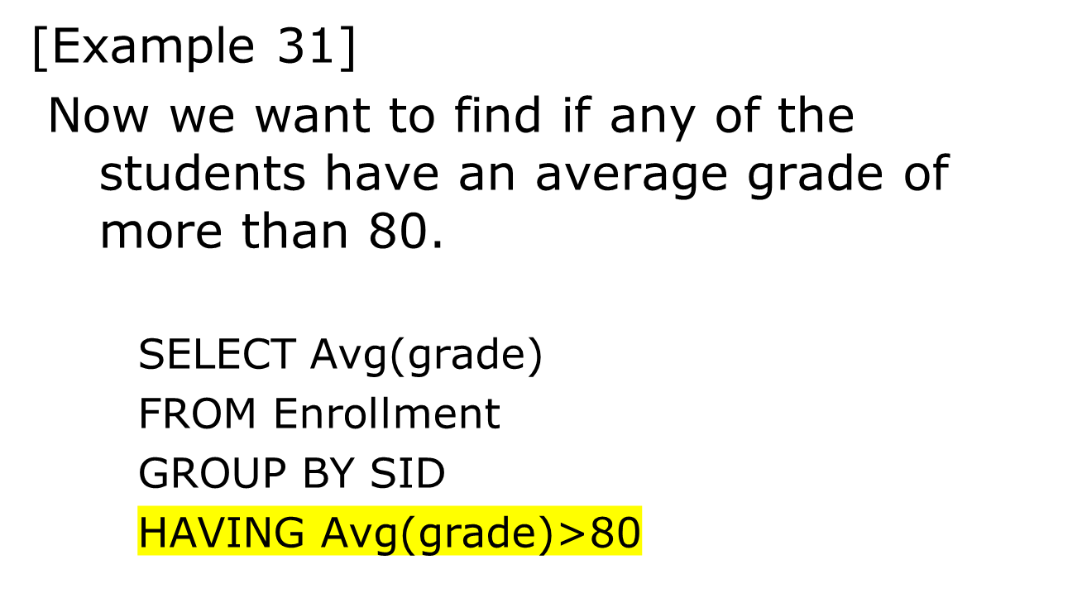
CON...

Slide 16
CON...
[Example]
Now we want to find if the students "2007001006" or "2006001001" have an average grade of less than 81.
    SELECT SID,Avg(grade)
    FROM Enrollment
    WHERE SID=2007001006 OR SID =2006001001
    GROUP BY SID
    HAVING Avg(grade)<81

Slide 17
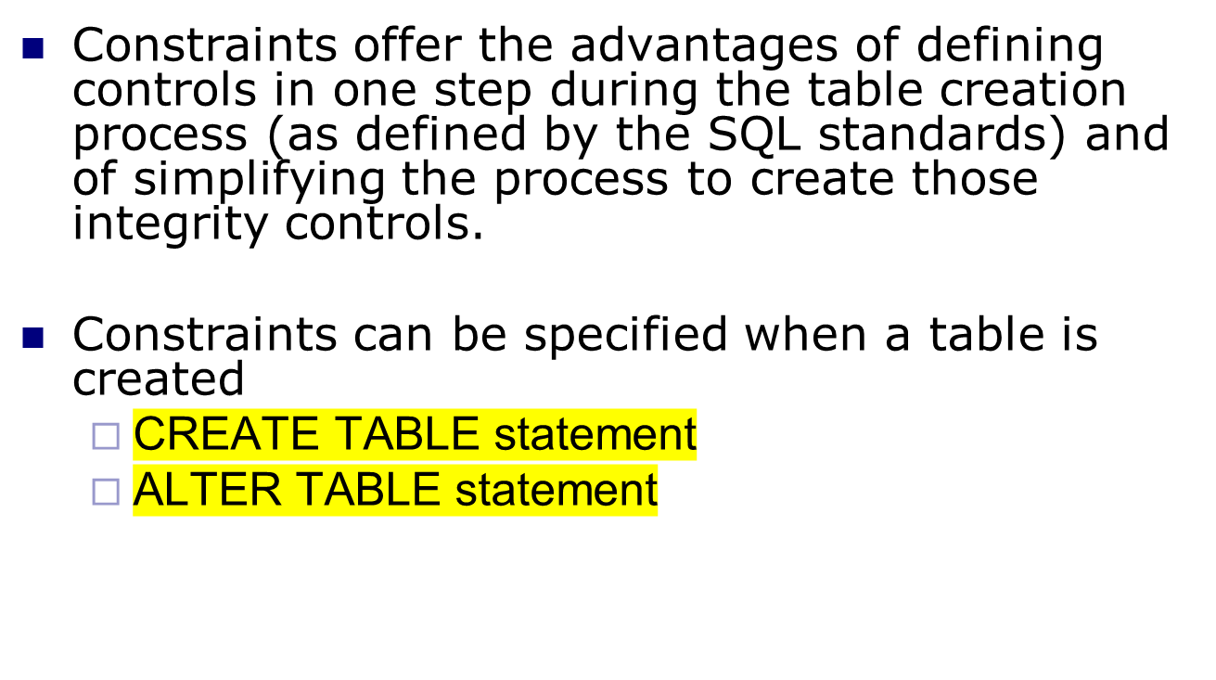
Specifying constraints

Slide 18
NOT NULL Constraint
The NOT NULL constraint enforces a field to always contain a value. This means that you cannot insert a new record, or update a record without adding a value to this field.
The following SQL enforces the "SSN" column and the "SNAME" column to not accept NULL values:
CREATE TABLE student
    (SSN NUMBER NOT NULL,
    SNAME CHAR(10) NOT NULL ,
    BirthDate DATE ,
    DEPTNO NUMBER);

Slide 19
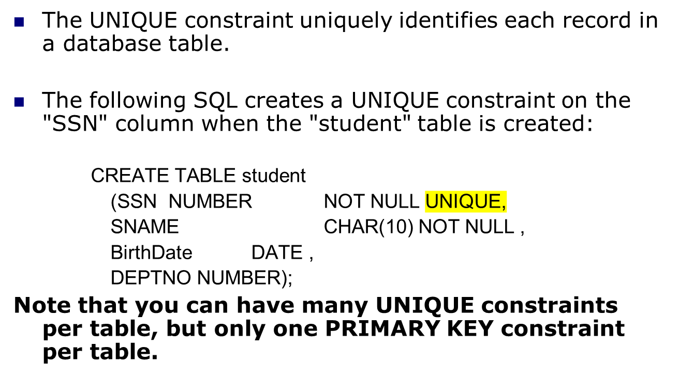
UNIQUE Constraint

Slide 20
PRIMARY KEY Constraint
The PRIMARY KEY constraint uniquely identifies each record in a database table.
A primary key must contain unique values and cannot contain NULL values.
Each table should have a primary key, and each table can have only ONE primary key

Slide 21
CON…
The following SQL creates a PRIMARY KEY on the " SSN " column when the " student " table is created:
    CREATE TABLE student
    (SSN NUMBER PRIMARY KEY,
    SNAME CHAR(10) NOT NULL ,
    BirthDate DATE ,
    DEPTNO NUMBER);

Slide 22
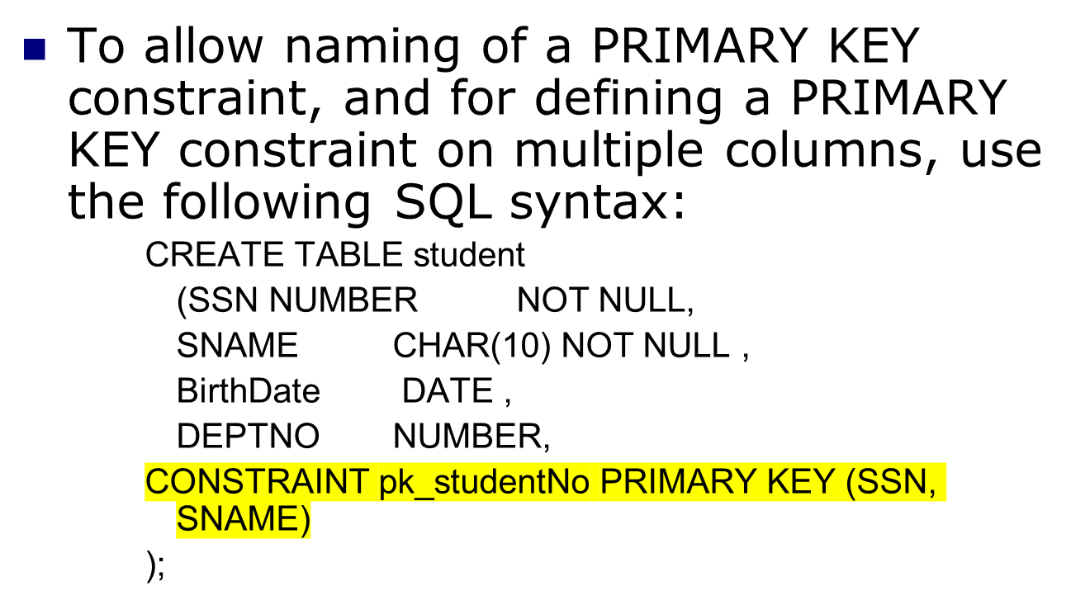
CON…

Slide 23
FOREIGN KEY Constraint
A foreign key is a referential constraint between two tables. The foreign key identifies a column or a set of columns in one (referencing) table that refers to a set of columns in another (referenced) table.
The columns in the referencing table must be the primary key or other candidate key in the referenced table.
The values in one row of the referencing columns must occur in a single row in the referenced table.
A row in the referencing table cannot contain values that don't exist in the referenced table

Slide 24
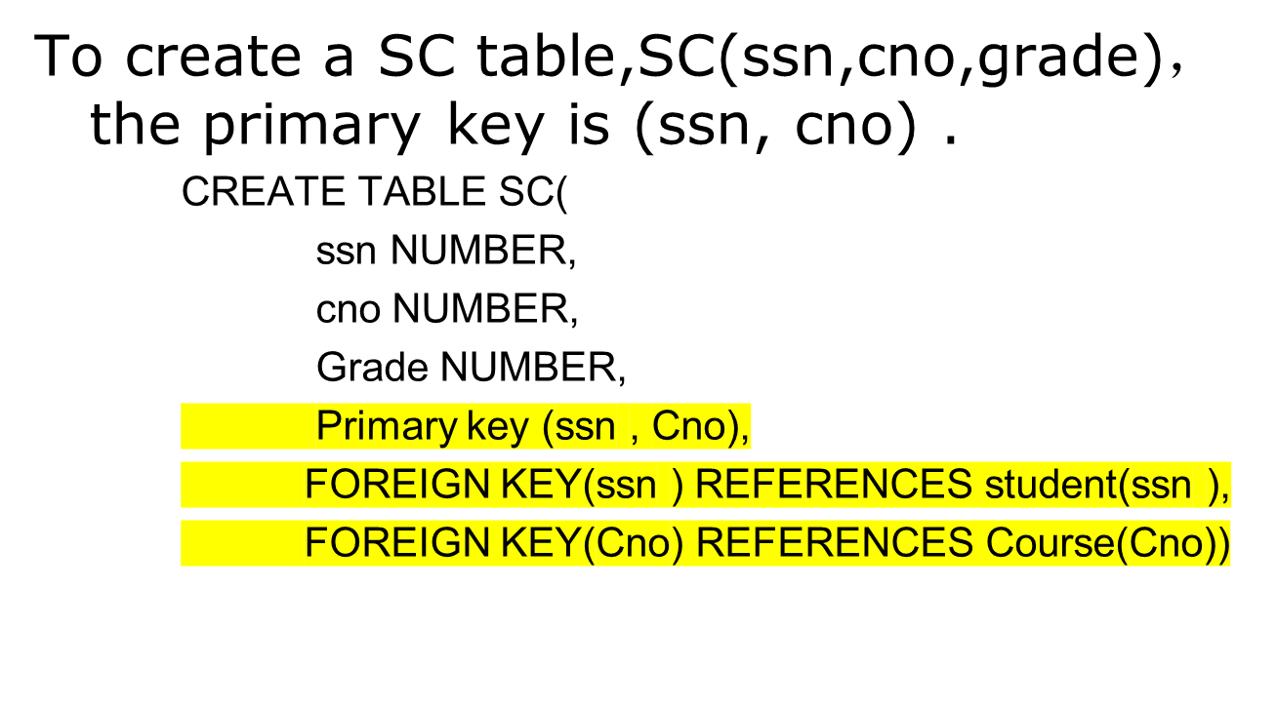
Example

Slide 25
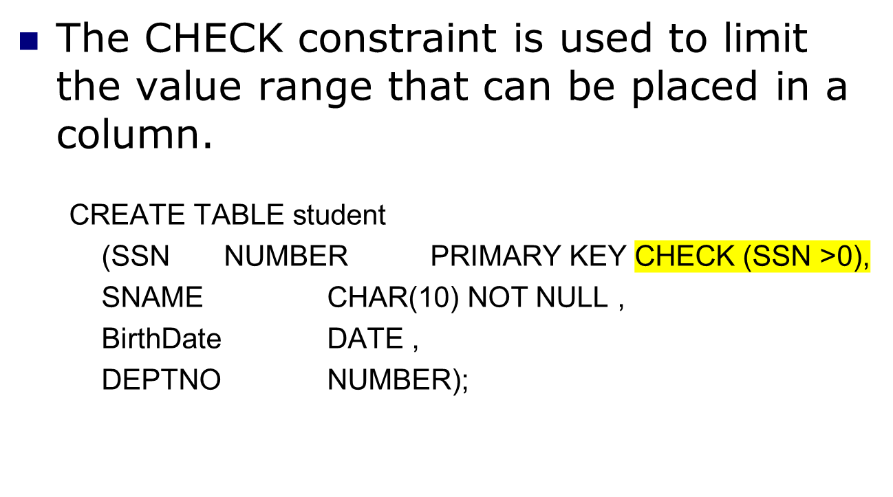
CHECK Constraint

Slide 26
DEFAULT Constraint
The DEFAULT constraint is used to insert a default value into a column. The default value will be added to all new records, if no other value is specified.
      CREATE TABLE student
      (SSN NUMBER PRIMARY KEY CHECK (sno >0),
      SNAME CHAR(20) NOT NULL ,
      BirthDate DATE ,
      DEPTNO NUMBER DEFAULT 00);

Slide 27
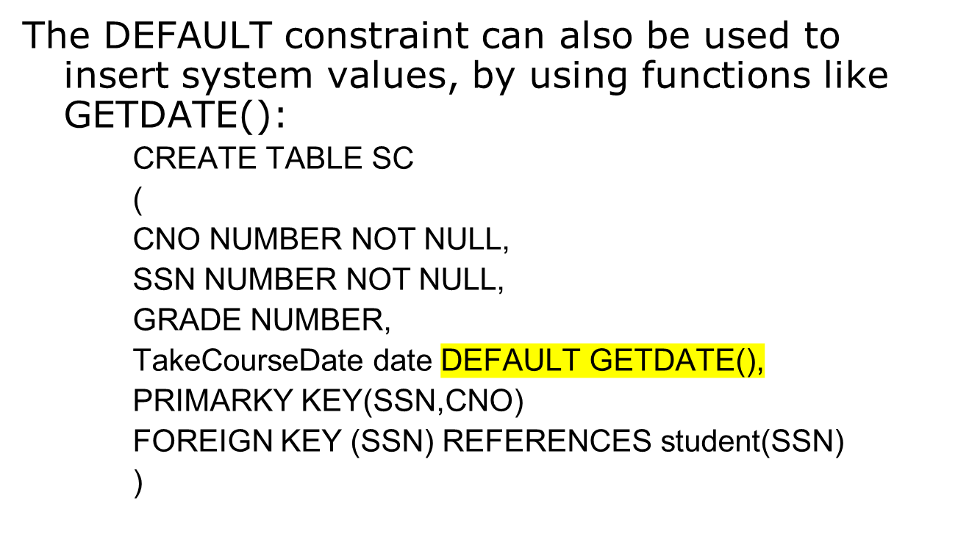
CON…

Slide 28
Creating indexes
索引
Indexes can be created against a table to make searches more efficient.
A book index allows you to find information without having to read through the whole book.
A database index enables the database application to find data quickly without having to scan the whole table.
根据表建立索引，加快记录的查询

Slide 29
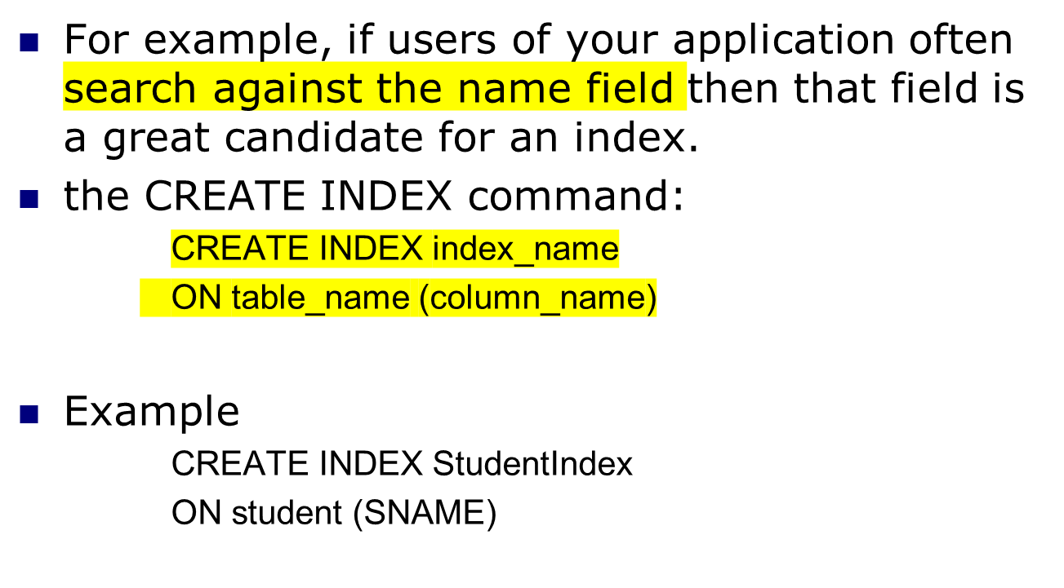
CON…

Slide 30
Example
If we have a table for recording students information, then the columns may include information such as student’s number(SSN), name(SNAME), birth date(BirthDate), depart number(DEPTNO).
  CREATE TABLE student
  (SSN NUMBER NOT NULL,
  SNAME CHAR(10) ,
  BirthDate DATE ,
  DEPTNO NUMBER);
Note that: The NOT NULL constraint enforces the field of SSN to always contain a value.
An Introduction to Database System

Slide 31
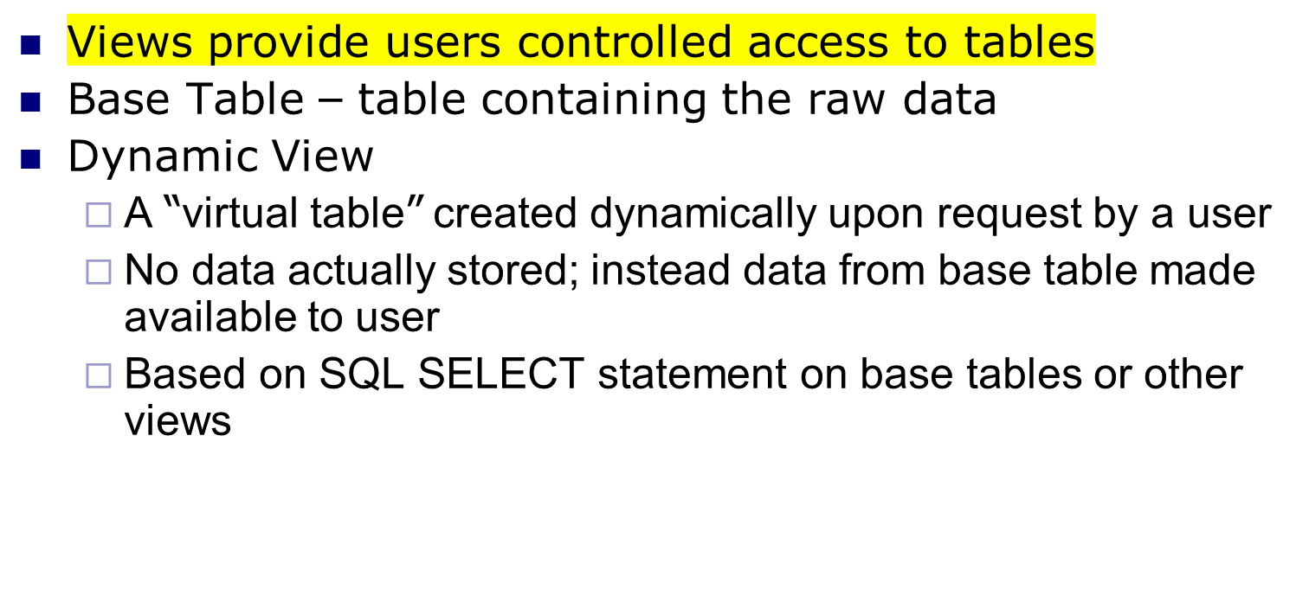
Using and Defining Views
视图
不同的视图对表具有不同的访问权限，即只可以访问部分语句

Slide 32
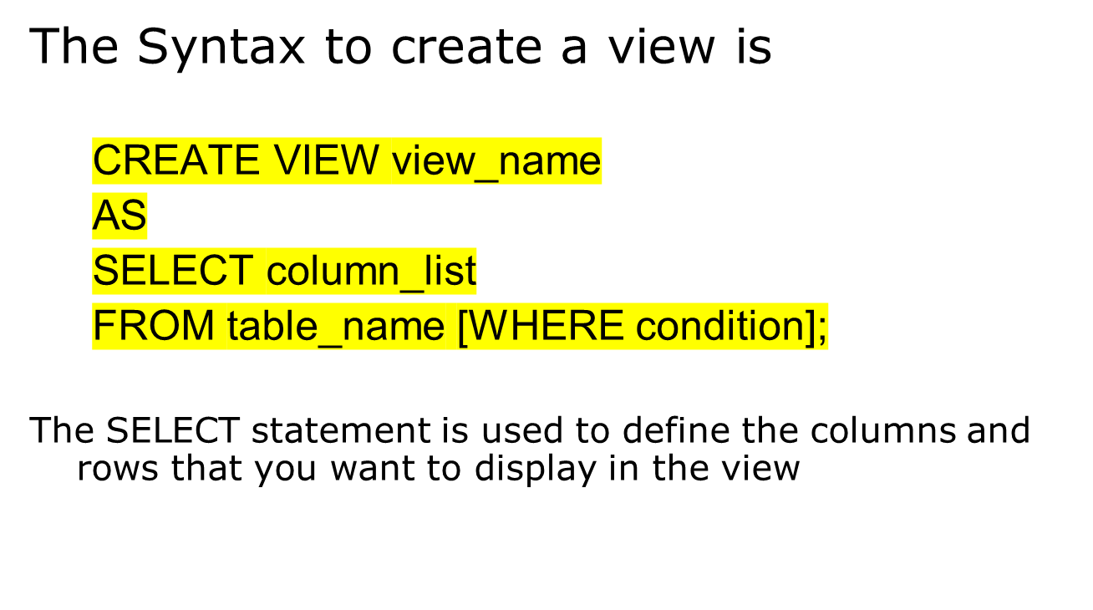
CREATE VIEW

Slide 33
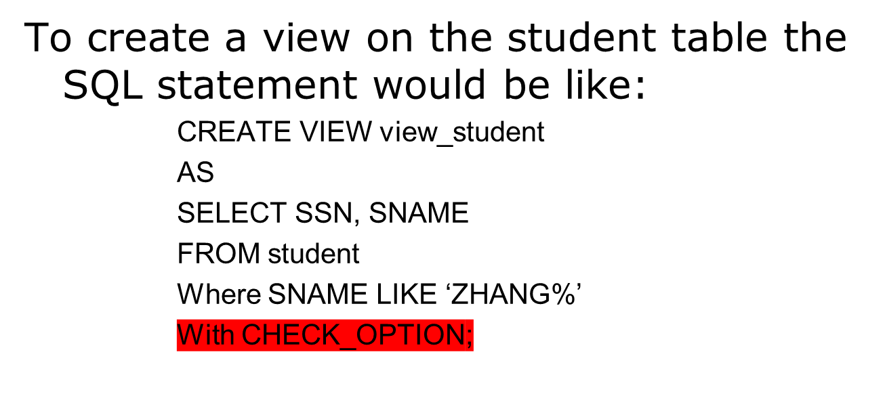
Example
View has a name
CHECK_OPTION works only for updateable views and prevents updates that would create rows not included in the view

Slide 34
ALTER VIEW
By the ALTER VIEW Statement we can change the definition of a view. This statement is useful to modify a view without dropping it.
The general syntax of ALTER VIEW Statement is :
ALTER VIEW view_name [(column_list)] [WITH ENCRYPTION] AS select_statement [WITH CHECK OPTION]

Slide 35
Example
A one more column by the name of Address of student table.
ALTER VIEW view_student
AS
SELECT sno, sname,Address
FROM student;

Slide 36
DROP VIEW
For dropping a view you can use the DROP VIEW Statement.
The general syntax of DROP VIEW Statement is :
DROP VIEW view_name;
  When view is dropped but it has no effect on the underlying tables.
  After dropping a view if you issue any query that reference a dropped view then you get an error message.
  But dropping a table that reference any view does not drop the view automatically. You have to dropt the view explicitly.

Slide 37
Advantages of Views
Simplify query commands
Assist with data security (but don't rely on views for security, there are more important security measures)
Enhance programming productivity
Contain most current base table data
Use little storage space
Provide customized view for user
Establish physical data independence

Slide 38
Disadvantages of Views
Use processing time each time view is referenced
May or may not be directly updateable

